Slide 1
ROBOTIC PROCESS AUTOMATION LABORATORY 21CSL75

Slide 2
Build a workflow using Web Recorder in UiPath Studio to Sign in to UiPath’s website. - Ask the user’s email address and password. - Open the sign in page of UiPath’s Website. - Sign in to the website using the user’s credentials.

Slide 3
Activities
Input Dialog
Open Browser
Web Recorder
Click
Type

Slide 4
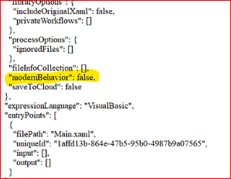

Slide 5
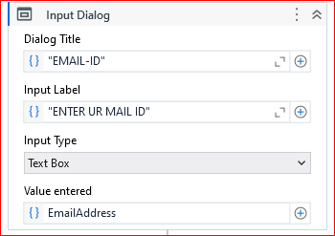

Slide 6
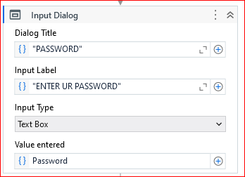

Slide 7
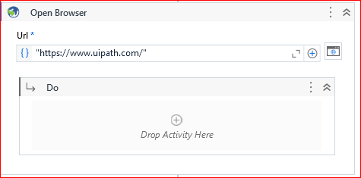

Slide 8

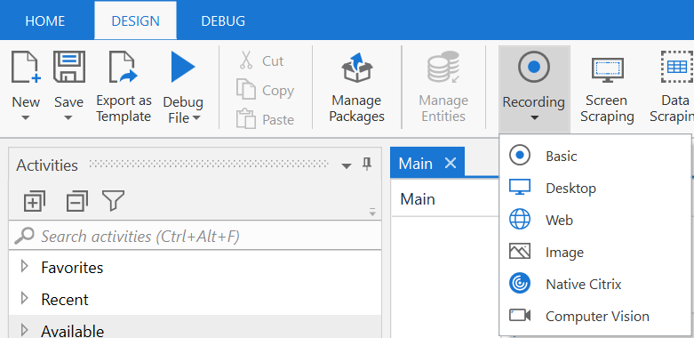
TASK Recoder
The recording functionality of UiPath Studio helps in capturing user’s actions on the screen and translating them into sequences.
The recording tool can be accessed from the ‘Design’ tab in UiPath Studio.
While recording, all user interface elements are highlighted, allowing easy identification of buttons, fields, menus, or elements with which the user interacts.
Once the recording ends, a sequence is created, containing the activities performed by the user.
Notes:
UiPath Studio recording is a technique that helps in capturing the manual actions of the user performed on the screen and translating them into sequences.
Recording is a crucial tool in UiPath Studio as it captures the step-by-step activity of the user. It automatically generates the sequence of all the workflows which are needed for automation. Recording helps in identifying the elements on the screen, reading data from display, and so on. Recording helps users to save a lot of time when automating the business processes.
All user interface elements are highlighted while recording to ensure that correct buttons, fields or menus are selected. The recorder can work with different types of applications, and different types of environments.

Slide 9
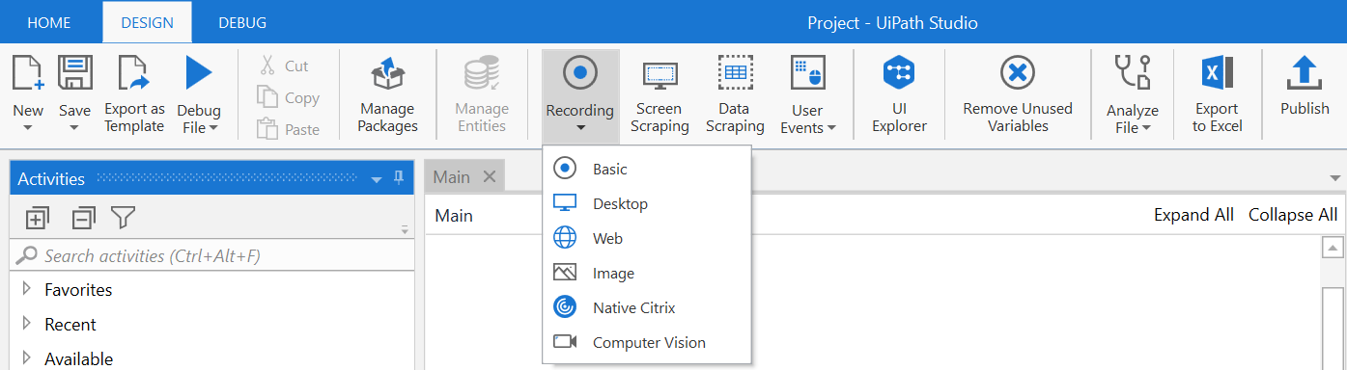
Types of Recording
UiPath Studio consists of six recorders that come with their own controllers to perform recording.
Basic Recording
Desktop Recording
Web Recording
Image Recording
Native Citrix Recording
Computer Vision Recording
Notes:
Recording:
In UiPath Studio, there are six types of recorders, and each comes with its own controllers to perform specific recording actions. These are:
Basic Recording
Desktop Recording
Web Recording
Image Recording
Citrix Recording
Computer Vision Recording
These are discussed in detail in the subsequent slides.

Slide 10
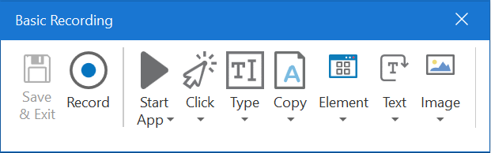
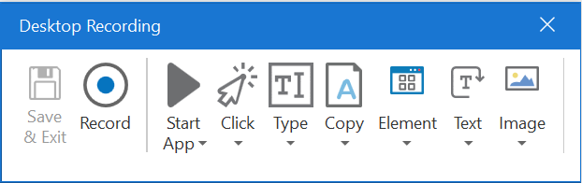
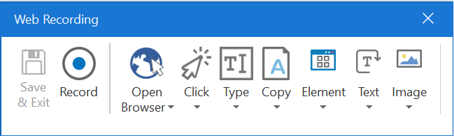
Basic, Desktop & Web Recording
Basic Recording
Generates a full selector for each activity and no container.
Desktop Recording
Suitable for all types of desktop apps and multiple actions.
Web Recording
Used for recording in web apps and browsers
Notes:
A. Basic Recording:
This recording generates a full selector for each activity with no container.
B. Desktop Recording:
This recording is suitable for all types of desktop apps.
C. Web Recording:
It is designed for recording in web apps and browsers, generates containers and uses the Simulate Type/Click input method by default.
All these recordings enable the user to:
Automatically record multiple actions performed on the screen such as Click, Type Into, Select Item and Check.
Manually record single actions, such as:
Starting or closing an application (Basic & Desktop recording) / Starting or closing web browser (Web recording)
Clicking an interface element
Selecting an option from a drop-down list
Selecting a check box
Simulating keystrokes or keyboard shortcuts
Copying text from a UI element or performing screen scraping
Looking for elements or waiting for them to vanish
Finding an image
Activating a window

Slide 11
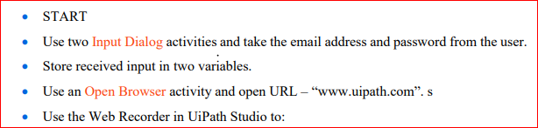
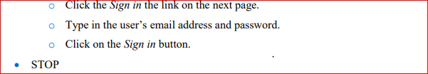

Slide 12
Mail : rpalab2024@gmail.com
Pwd : Rpa@bitm2024

Slide 13
Build a workflow using Format, Join, IndexOf, Split, and Substring methods that extract key information from a text and prints in a different format. - Use the text "You always wanted to study Automation Training. The materials are available in the following : UiPath Blog, UiPath Academy.” for extraction. - Extract “Automation Training” from the first sentence. - Extract “UiPath Blog” and “UiPath Academy” from the second sentence. - Display “study Automation Training from: UiPath Blog; UiPath Academy” in a message box.

Slide 14
Activities used
Sequence
Assign
String Methods

Slide 15
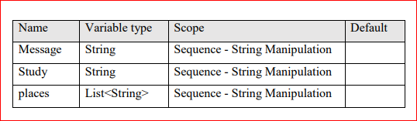
Places : System.Collections.Generic.List<System.String>

Slide 16
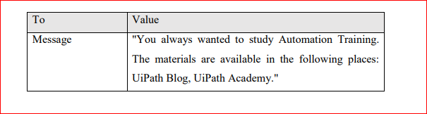

Slide 17
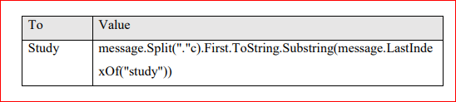

You always wanted to study Automation Training.

Slide 18

study Automation Training.

Slide 19


The materials are available in the following places: UiPath Blog, UiPath Academy.

Slide 20
UiPath Blog, UiPath Academy.

Slide 21
Places : UiPath Blog, UiPath Academy.

Slide 22
String.Format: This method formats a string using placeholders like {0}, {1}, etc. Each placeholder is replaced by the corresponding value passed as arguments.
{0} will be replaced by the value of study.
{1} will be replaced by the result of String.Join(";", places).
String.Join(";", places): This method takes an array or collection of strings, places, and joins them into a single string with each element separated by ;.

Slide 23
Build a workflow using Split and Contains methods that extract sentences containing “RPA” from a paragraph. - Store a paragraph in a string variable using an Assign activity. - Store all sentences from the text in an array using a Split method. - Loop through each sentence and identify sentences containing “RPA” using Contains method. - Store all identified sentences in an MS Word file.

Slide 24
ACTIVITIES USED
Sequence
Assign
For each
If
Attach Window
Type Into

Slide 25
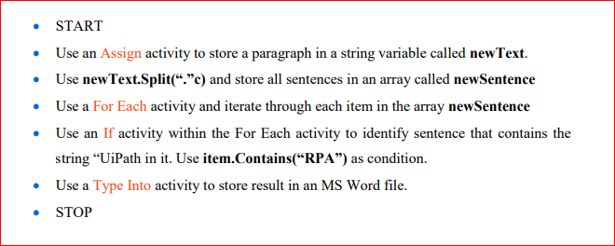

Slide 26
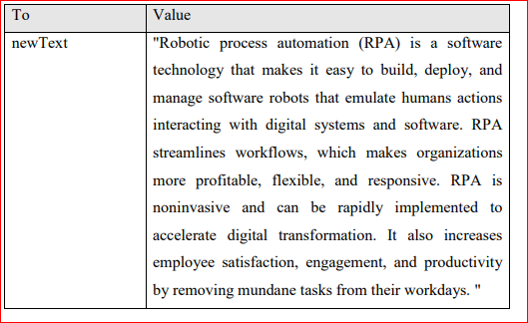

Slide 27


Slide 28
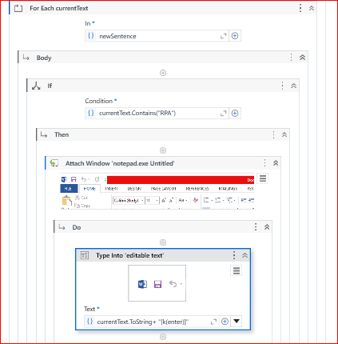

Slide 29
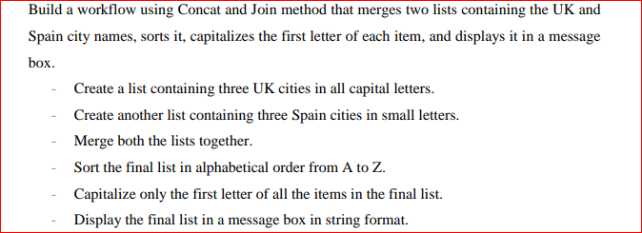

Slide 30
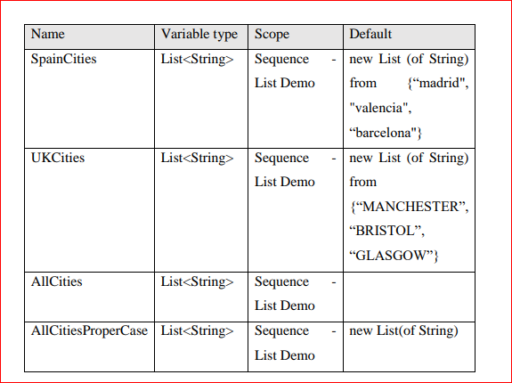

Slide 31
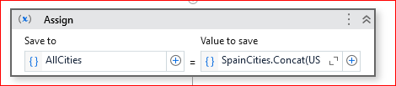


Slide 32
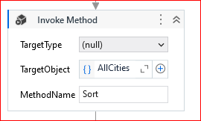

Slide 33
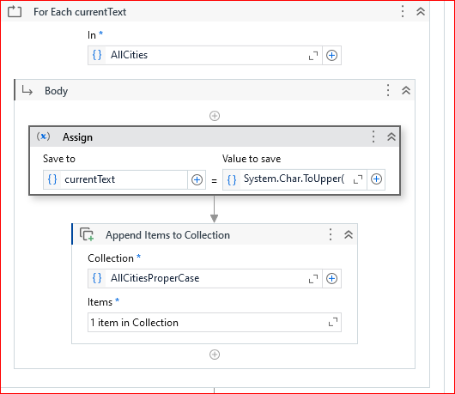
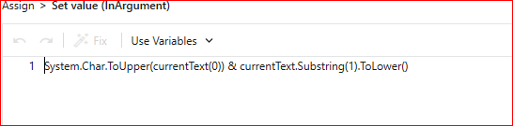

Slide 34


Slide 35
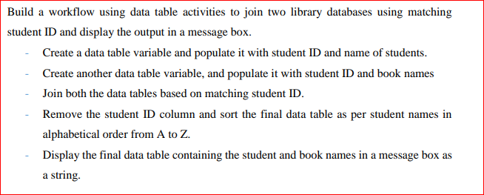

Slide 36
Activities
Build Data Table
Join Data Table
Remove Data Column
Sort Data Table
Output Data Table
Message Box

Slide 37
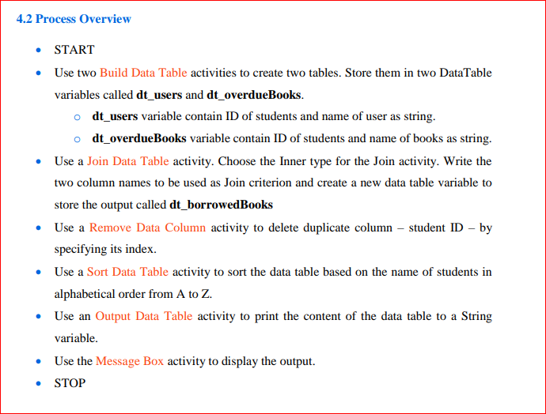

Slide 38
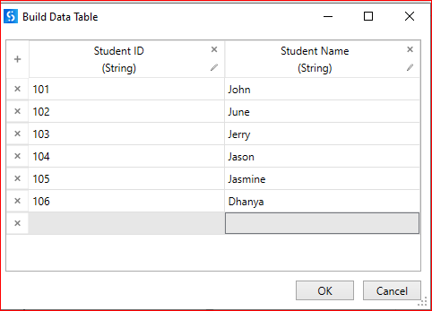

Slide 39
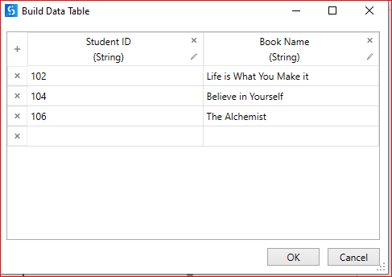

Slide 40
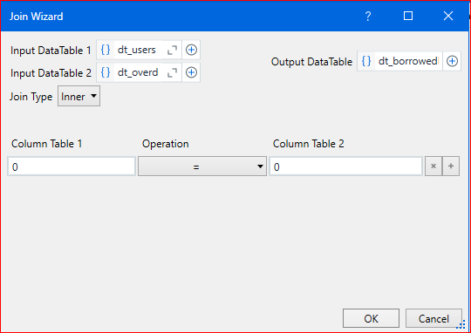

Slide 41
Student Id | Student Name | Student Id | Book Name
102 | June | 102 | Life is what u make it
104 | Jason | 104 | Believe in Yourself
106 | Dhanya | 106 | The Alchemist

Slide 42
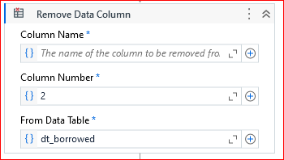

Slide 43

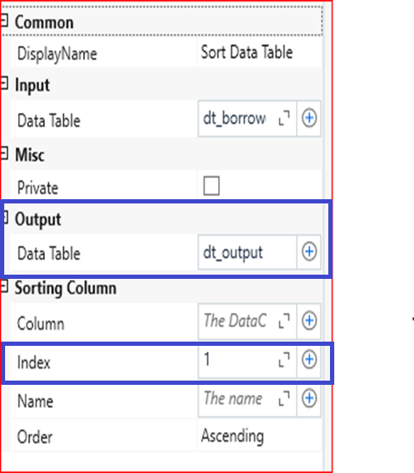

Slide 44
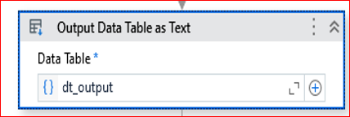
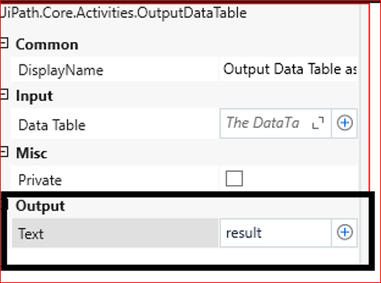

Slide 45
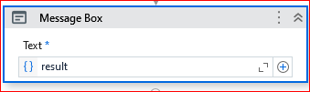

Slide 46
7. Build a workflow using the Data Scraping wizard that scrapes blog post titles from the UiPath Blog from multiple pages. - Open the UiPath Blog (https://www.uipath.com/blog). - Extract all blog titles and URL by navigating through all pages. - Store scraped data in an Excel file

Slide 47
Activities used for
Open Browser
Data Scrapping
Write CSV file

Slide 48
START
Use an Open Browser activity and enter the URL – www.uipath.com/blog.
Use the Data Scraping button in the Design ribbon to indicate the first two blog post titles
Rename “Column1” to “Blog Titles”.
Use the Indicate Next Link window of the Data Scraping tool to indicate the Next link in the search results page.
Use Write CSV activity and save the data in a CSV file.
STOP

Slide 49
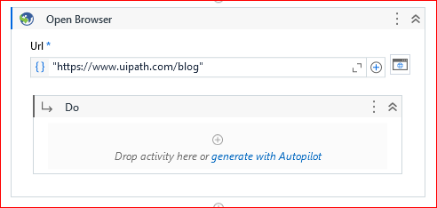
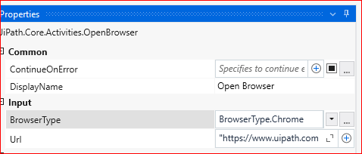

Slide 50
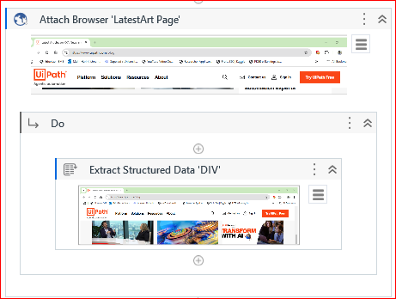

Slide 51
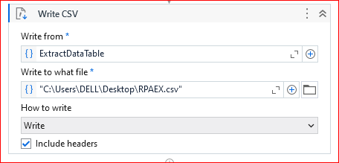

Slide 52
6. Build a workflow using a Screen Scraper Wizard that scrapes text using the Tesseract OCR scraping method from an image and stores it in a Notepad. - Search for “text images” in Google Images. - Pick one image containing text from the search results. - Scrape the text from the image using Tesseract OCR. - Store text in a Notepad file

Slide 53
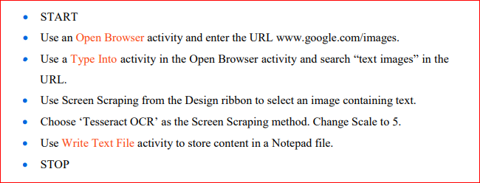

Slide 54
Activities used
Sequence
Open Browser
Type into
Send HotKey
Screen scrapping
Write text to file

Slide 55
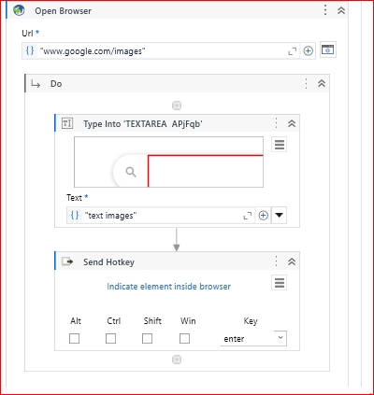
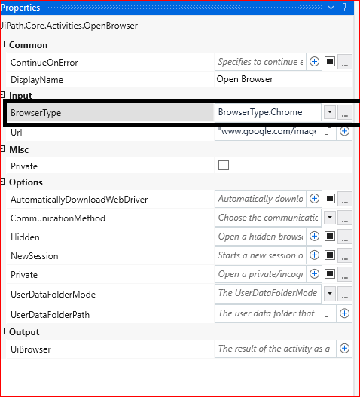

Slide 56
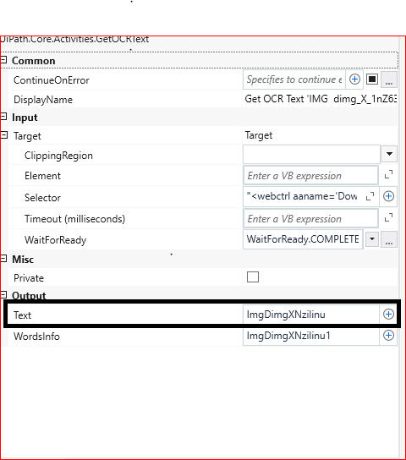
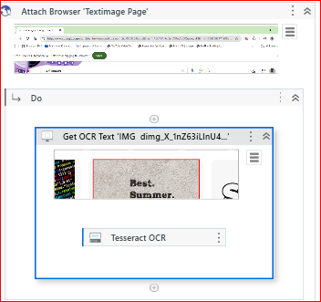

Slide 57
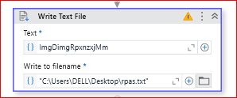

Slide 58
Build a workflow using a Read PDF Text activity and extract only Email IDs and Phone Numbers from a PDF file and store it in an MS Word file. - Read data from the PDF file using a Read PDF Text activity. - Extract only Phone Numbers and email IDs from the PDF and store it in an MS Word file

Slide 59
Activities used
Sequence
Read PDF Text
Find Matching Patterns- Emails
Find Matching Patterns-Phone NO
For Each-Emails
For Each-Phone No
Send HotKey

Slide 60
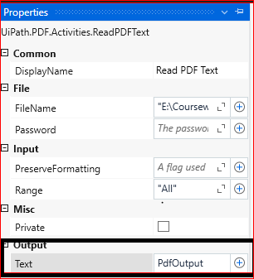
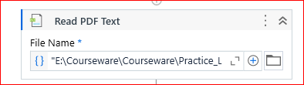

Slide 61

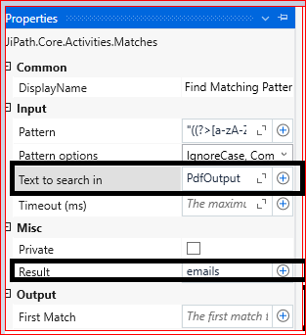
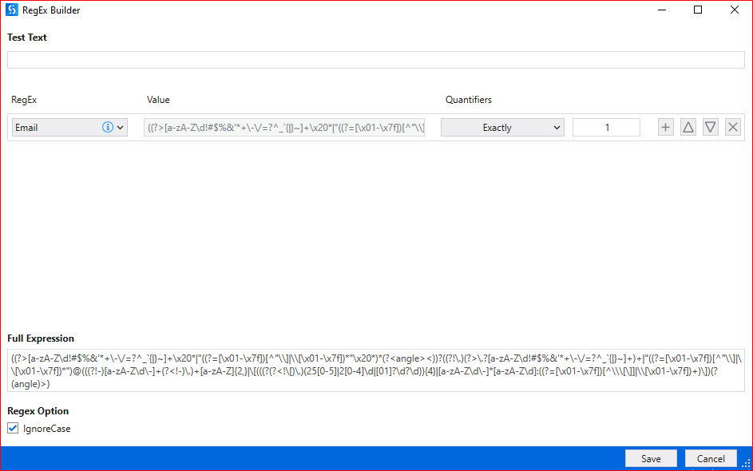

Slide 62
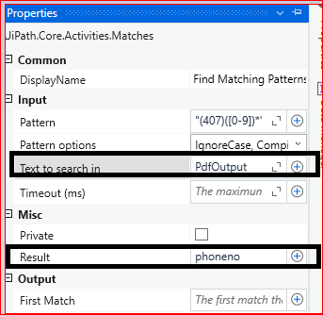
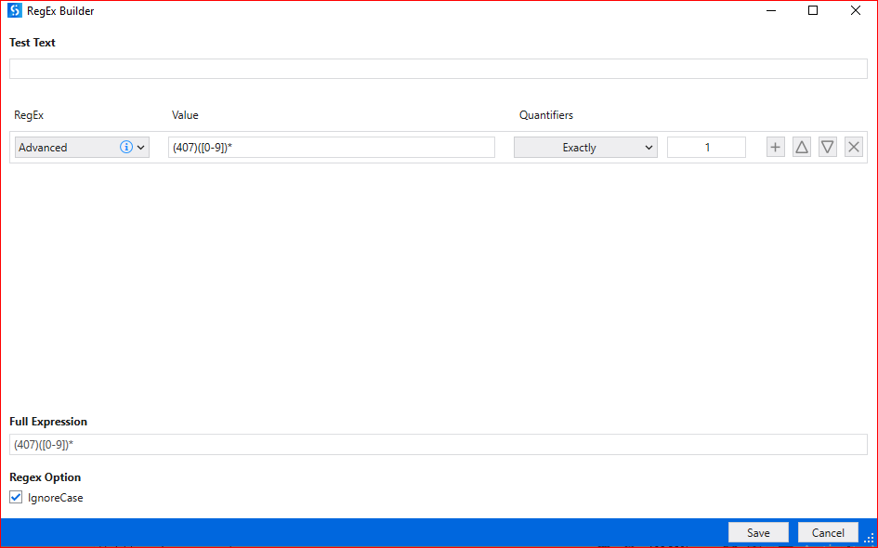

Slide 63
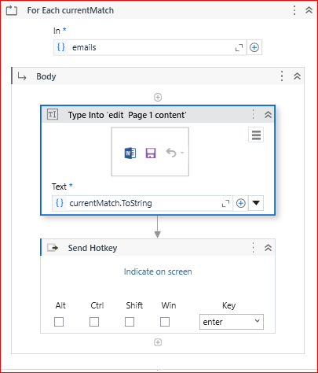

Slide 64


Slide 65
Build a workflow to display file names from a folder in the Output panel and also store names in an MS Word file. - Locate and select a folder containing multiple files. - List the directory path of all the files in the Output panel. - Also, store the updated names in an MS Word file and save and close it.

Slide 66
Activties
Sequence
Browse for Folder
Assign
Attach Window---(Select Ms word)
For Each
WriteLine
TypeInto
Send HotKey
Click

Slide 67


Slide 69


Slide 70



Slide 71


Slide 72


Slide 73


Slide 74


Slide 75


Slide 76


Slide 77


Slide 78


Slide 79



Slide 80



Slide 81


